Slide 1

Python Basics

Slide 2
Built-in Data Types: Numeric Data
Python has two main built-in numeric classes that implement the integer and floating point data types. These Python classes are called int and float.
The standard arithmetic operations, +, -, *, /, and ** (exponentiation), can be used. Parentheses forcing the order of operations away from normal operator precedence.
Other very useful operations are the remainder (modulo) operator, %, and integer division, //. Note that when two integers are divided, the result is a floating point. The integer division operator returns the integer portion of the quotient by truncating any fractional part.

Slide 3
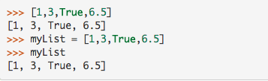
Built-in Collection Types
Lists: A list is an ordered, mutable collection of zero or more references to Python data objects. Lists are written as comma-delimited values enclosed in square brackets. The empty list is simply [ ].
Lists are heterogeneous, meaning that the data objects need not all be from the same class and the collection can be assigned to a variable as below.

Slide 4
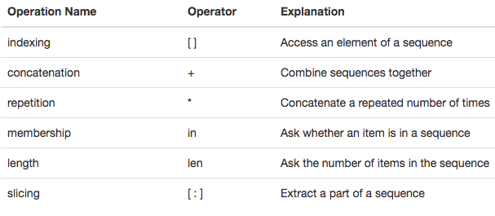
Operations on Lists

Slide 5
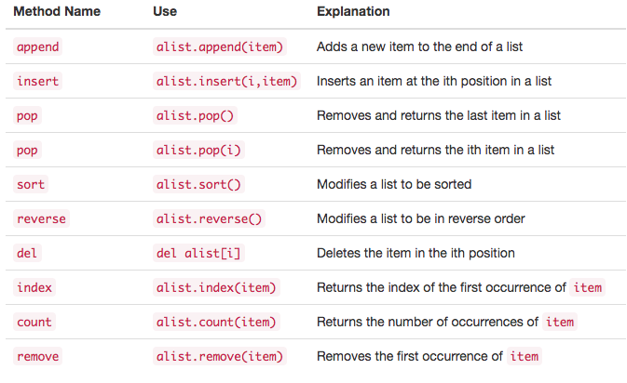
List Methods
A method is a function that “belongs to” an object

Slide 6
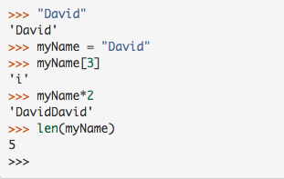
Strings
Strings: Strings are sequential, immutable, collections of zero or more letters, numbers and other symbols. We call these letters, numbers and other symbols characters. String values are differentiated from identifiers by using quotation marks (either single or double).
Notes:
Since strings are sequences, all of the sequence operations described above work as you would expect.

Slide 7
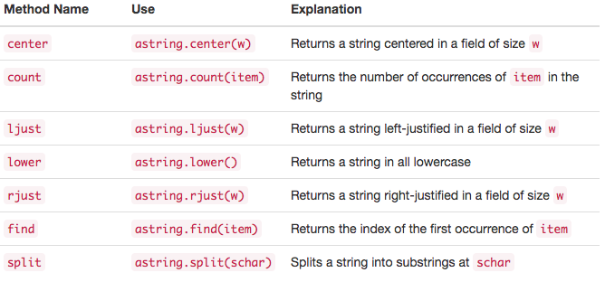
String Methods
Notes:
Split is very important for processing data, DS students take note pls.

Slide 8
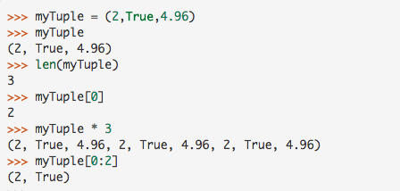
Tuples
Tuples are very similar to lists in that they are heterogeneous sequences of data. The difference is that a tuple is immutable, like a string. A tuple cannot be changed. Tuples are written as comma-delimited values enclosed in parentheses.

Slide 9
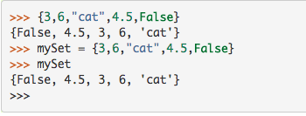
Set
A set is an unordered collection of zero or more immutable, unique, Python data objects. Sets do not allow duplicates and are written as comma-delimited values enclosed in curly braces.

Slide 10
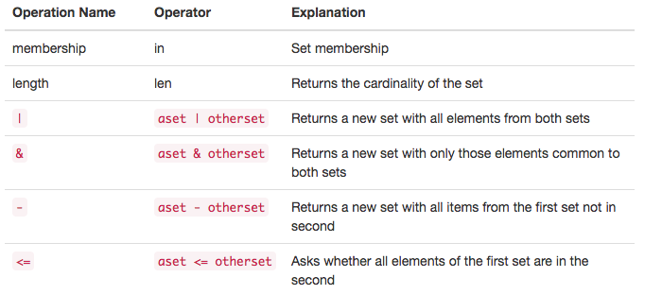
Familiar Operations on Sets

Slide 11
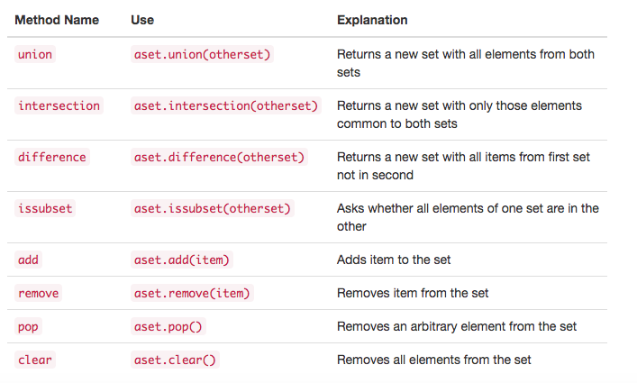
Set Methods

Slide 12

Dictionaries
Dictionaries are unordered collections of associated pairs of items where each pair consists of a key and a value. This key-value pair is typically written as key:value.

Slide 13
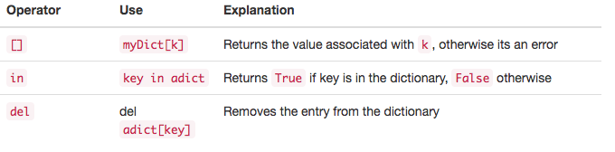
Operations on Dictionaries

Slide 14
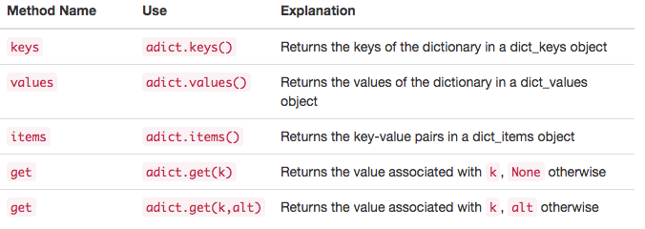
Dictionary Methods

Slide 15
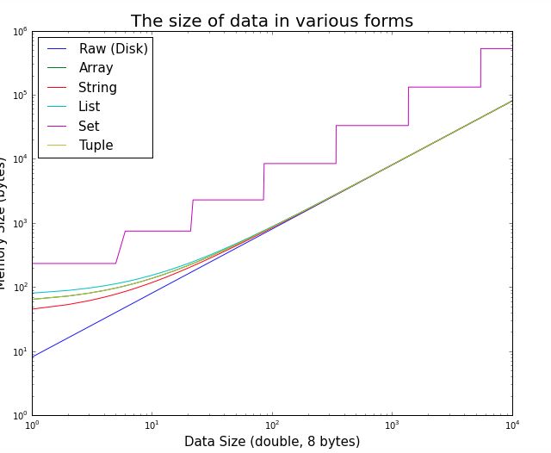
Tuples are considered the most memory efficient data type

Slide 16
Input/Output
We often have a need to interact with users, either to get data or to provide some sort of result. Python provides us with a function that allows us to ask a user to enter some data and returns a reference to the data in the form of a string. The function is called input().
Python’s input function takes a single parameter that is a string.
Now whatever the user types after the prompt will be stored in the aName variable

Slide 17
Control flow/Structures
There are two important control structures: iteration and Conditional/selections.
For iteration, Python provides a standard while statement and a very powerful for statement. The while statement repeats a body of code as long as a condition is true.
The for statement can be used to iterate over the members of a collection, so long as the collection is a sequence.
Selection or Conditional statements allow programmers to ask questions and then, based on the result, perform different actions.

Slide 18
Nested Loops and Alternatives
Selection constructs, as with any control construct, can be nested so that the result of one question helps decide whether to ask the next.
An alternative syntax for this type of nested selection uses the elif keyword. The else and if (“else if”) are combined so as to eliminate the need for additional nesting levels. Note that the final else is still necessary to provide the default case if all other conditions fail.

Slide 19
Infinite Monkey Theorem
Here’s a self check that really covers everything so far. You may have heard of the infinite monkey theorem? The theorem states that a monkey hitting keys at random on a typewriter keyboard for an infinite amount of time will almost surely type a given text, such as the complete works of William Shakespeare. Well, suppose we replace a monkey with a Python function. How long do you think it would take for a Python function to generate just one sentence of Shakespeare? The sentence we’ll shoot for is: “methinks it is like a weasel”
The way we’ll simulate this is to write a function that generates a string that is 27 characters long by choosing random letters from the 26 letters in the alphabet plus the space. We’ll write another function that will score each generated string by comparing the randomly generated string to the goal. A third function will repeatedly call generate and score, then if 100% of the letters are correct we are done. If the letters are not correct then we will generate a whole new string.To make it easier to follow your program’s progress this third function should print out the best string generated so far and its score every 1000 tries.

Slide 20
Exception Handling
There are two main types of errors: syntax and Logic errors.These types of runtime errors are typically called exceptions.
In Python, we deal with these errors that will allow the programmer to have some type of intervention if they so choose. In addition, programmers can create their own exceptions if they detect a situation in the program execution that warrants it.
When an exception occurs, we say that it has been “raised.” You can “handle” the exception that has been raised by using a try statement.

